Slide 1

Fast N² t-distributed Stochastic Neighbor Embedding Andreas Blöchinger Marc Fischer Alberto Montes Marko P. Trauber
TexPoint fonts used in EMF.
Read the TexPoint manual before you delete this box.: AAAAA

Slide 2
Algorithm
Notes:
This is the algorithm as it is in the literature, but we simply look at what it does -> next slide
DON’T SPEND MUCH TIME HERE
10s

Slide 3
Algorithm on MNIST
Notes:
We have images of handwritten digits (0 -9)
They are very high dimensional vectors (784) and we don’t know any thing about the structure.
The Algorithm gives us a low dimensional picture of the groups in that data set.
Used for exploration of data sets in machine learning.
20s

Slide 4

Algorithm as we implemented it
Part 1
Part 2
Part 3
Notes:
Our algorithm.
Describe that it takes high dimensional X, and outputs low dimensional Y.
Roughly describe parts.
Those 3 parts are also, how we divided the optimization.
We use float.
1 min

Slide 5
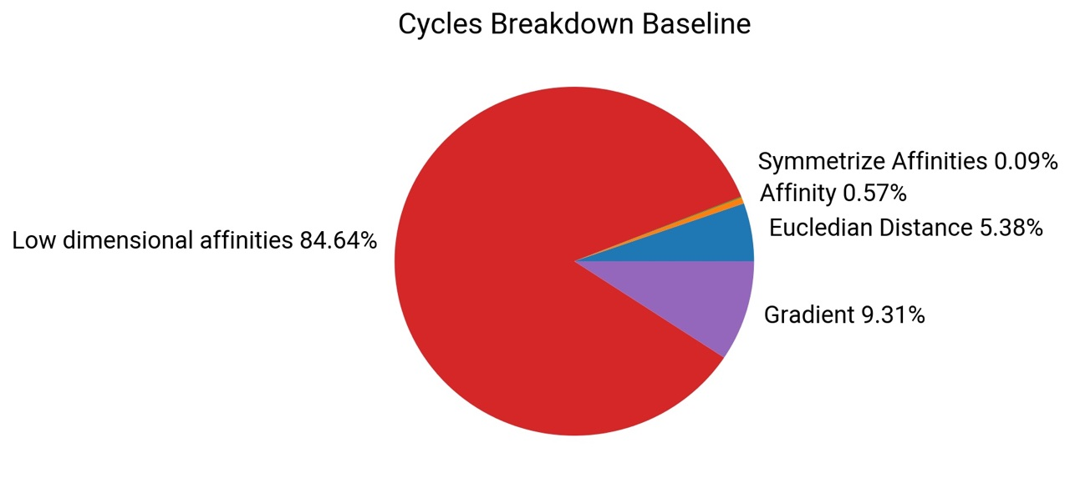
Notes:
Euclidian Distance – Part 1
Symmetrize affinities + affinity – Part 2
Gradient + Low dimensional affinities – Part 3
Part 1 is the only part that depends on the input dimensionality D.
So part 3 most important and Part 1 for very large D

Slide 6
Experimental Setup
Euler III: Intel Xeon E5-1585Lv5 3.0 GHz
Architecture: Skylake (AVX2.0)
Cache:
L1 Cache: 32 KB
L2 Cache: 256 KB
L3 Cache: 8 MB
Compiler: ICC 16.0
Notes:
For all performance and runtime values that we are going to give in this presentation, we used Euler III.
We use icc because the exp_ps intrnsic is only available there.

Slide 7

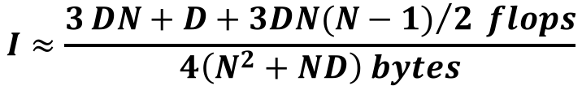
Part 1: Data preprocessing
$$I≈\frac{3{DN+D+3DN(N−1)}/2 flops}{4\left(N^{2}+ND\right) bytes}$$
Notes:
Remember: We use float.
OI: Depending on N/D either O(D) or O(1)
Approach: Unrolling + Scalar Repalcement + Strength Rediction + Accumulators -> Best Scalar
Intrinsics -> Naïve AVX
Blocking + better AVX handling -> Blocking AVX.
Depending on D we can also get to ~20 FLOP, but 15-16 is the usual case. 24 is best possible based on inner loop. So the maximum is likely around 20.

Slide 8
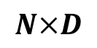

Part 1: Optimized Version, Normalization
float *X =
$$N×D$$
x_{0,0}
x_{0,1}
x_{0,2}
x_{0,3}
x_{0,4}
x_{0,5}
x_{0,6}
x_{0,7}
x_{1,0}
x_{1,1}
x_{1,2}
x_{1,3}
x_{1,4}
x_{1,5}
x_{1,6}
x_{1,7}
$$D$$
float *means =
runningMax[0:7] = 0
for k=0:8:D
accum0[0:7] = 0 ... accum7[0:7] = 0
for i=0:8:N
accum0[0:7] += X[i][k:k+7]
...
accum7[0:7] += X[i+7][k:k+7]
Reduce accumuators into means
Multiply means with 1/N
for i=0:8:N
X[i][k:k+7] -= means[k:k+7]
runningMax = max(runningMax, abs(X[i][k:k+7]))
Notes:
I disabled the slide
It is not too important and only takes time

Slide 9


Part 1: Optimized Version, Distance
float *X =
$$N×D$$
x_{0,0}
x_{0,1}
x_{0,2}
x_{0,3}
x_{0,4}
x_{0,5}
x_{0,6}
x_{0,7}
x_{1,0}
x_{1,1}
x_{1,2}
x_{1,3}
x_{1,4}
x_{1,5}
x_{1,6}
x_{1,7}
for i=0:8:N
for j=i+8:8:N
for i'=i:i+8
accum0[0:7] = 0 ... accum7[0:7] = 0
for k=0:8:D
dist0[0:7] = X[i][k:k+7]
- X[j][k:k+7]
accum0[0:7] += dist0*dist0
...
dist7[0:7] = X[i+7][k:k+7]
- X[j+7][k:k+7]
accum7[0:7] += dist7*dist7
Reduce 8 accums into res[0:8]
Multiply by factor
Store res as 1 row in upper block
Transpose 8 rows and store lower block
float *DD =
$$N$$
$$N$$
Notes:
The Euclidian distances in Part 1.
We access data in 8x8 blocks (8x8 X vectors)
This gives locality within X and DD
Within those 8x8 blocks we access data in 8 dimension strides
This allows unrolling with 8 accumulators and the use of FMAs
45s

Slide 10
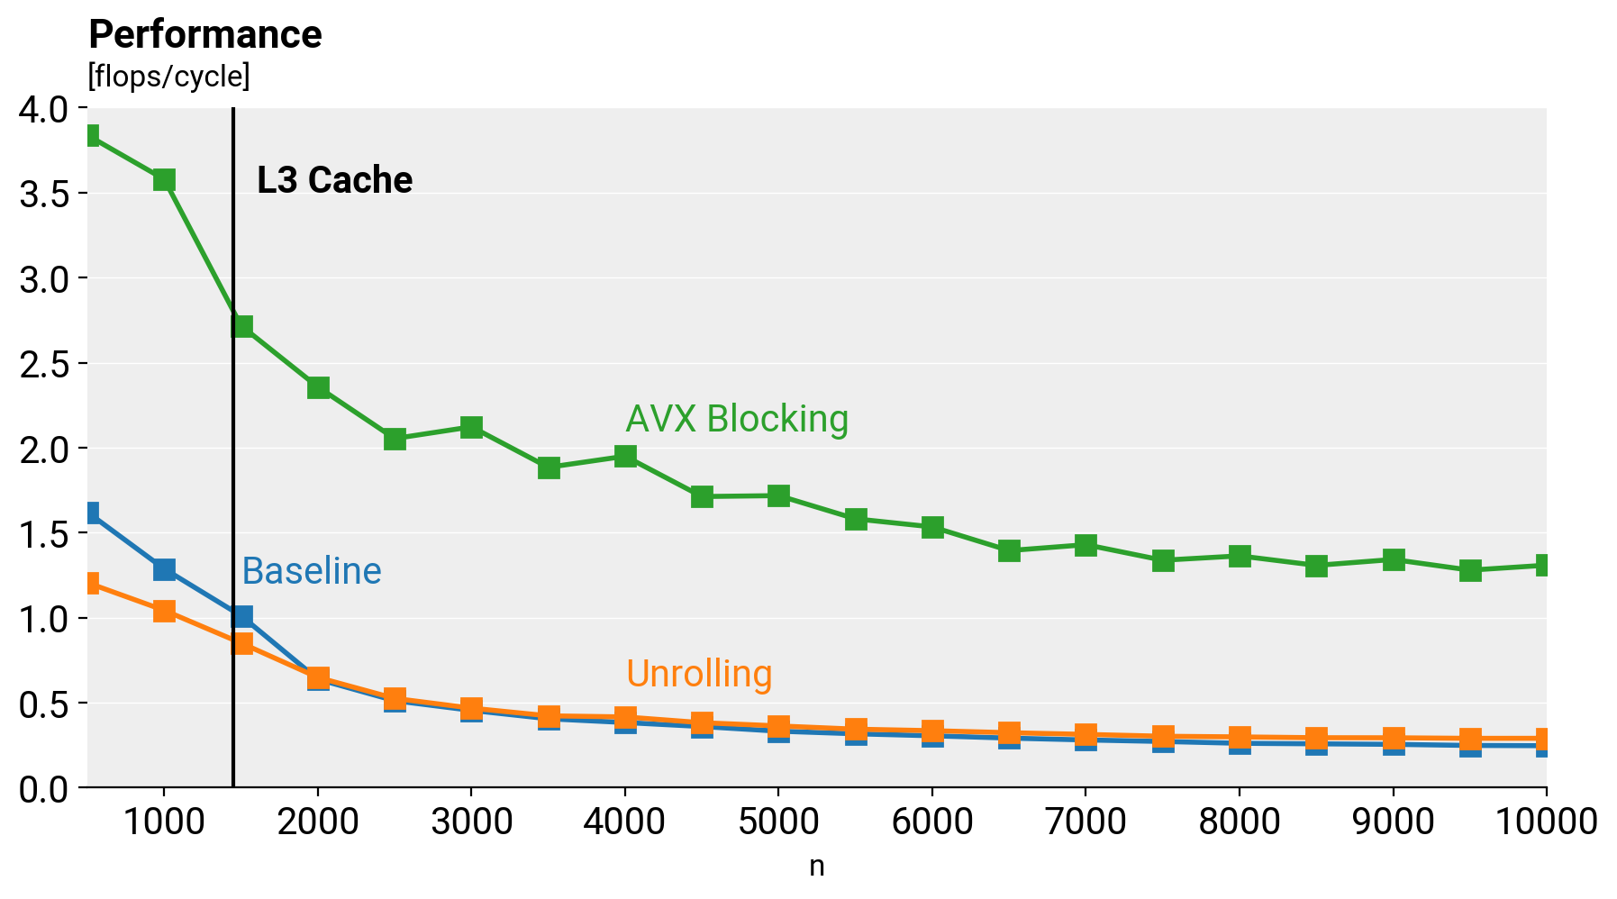
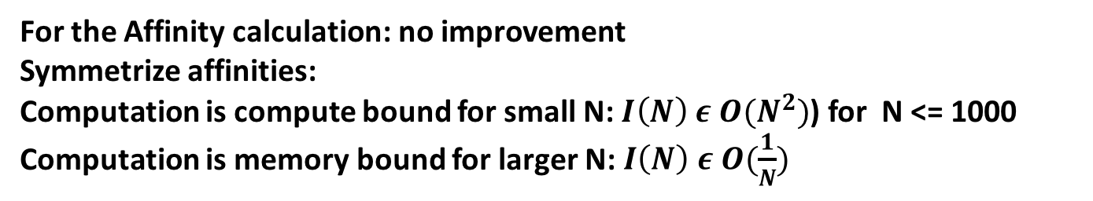

$$p_{ij}= \frac{p_{ij} + p_{ji}}{2}$$
Part 2: Symmetrize affinities
+ normalize per row
For the Affinity calculation: no improvement
Symmetrize affinities:
Computation is compute bound for small N: $I\left(N\right) ε O(N^{2})$) for N <= 1000
Computation is memory bound for larger N: $I\left(N\right) ε O(\frac{1}{N})$
Notes:
2 Steps: Compute affinities = Binary Search part (no improvement despite big effort, but only 0.5% of runtime); Symmetrice affinities
We want to symmetrice the matrix of high dimensional affinities p_ij. We basically add the transpose of the matrix and divide by 2.
We are using 8*8 blocking for avx as we are trying to deal with N stride access -> pij = pji + pij
we are storing the sum of the computed symmetrized pij on the fly and using the last loop for computing the early exageration(multipication by a constant) and normalization by the computed sum -> using avx vectors for that. we are using fmas and ilp for computing within the blocks of symmetrization (as we have crssoings for the blocks that contain diagonal elements)
performance: not as good as expected (8* speedup expected, but 4 times got) as we are using a lot of set ps instructions which are very costly -> idea with using transpose of 8*8 block is a way to go
10

Slide 11
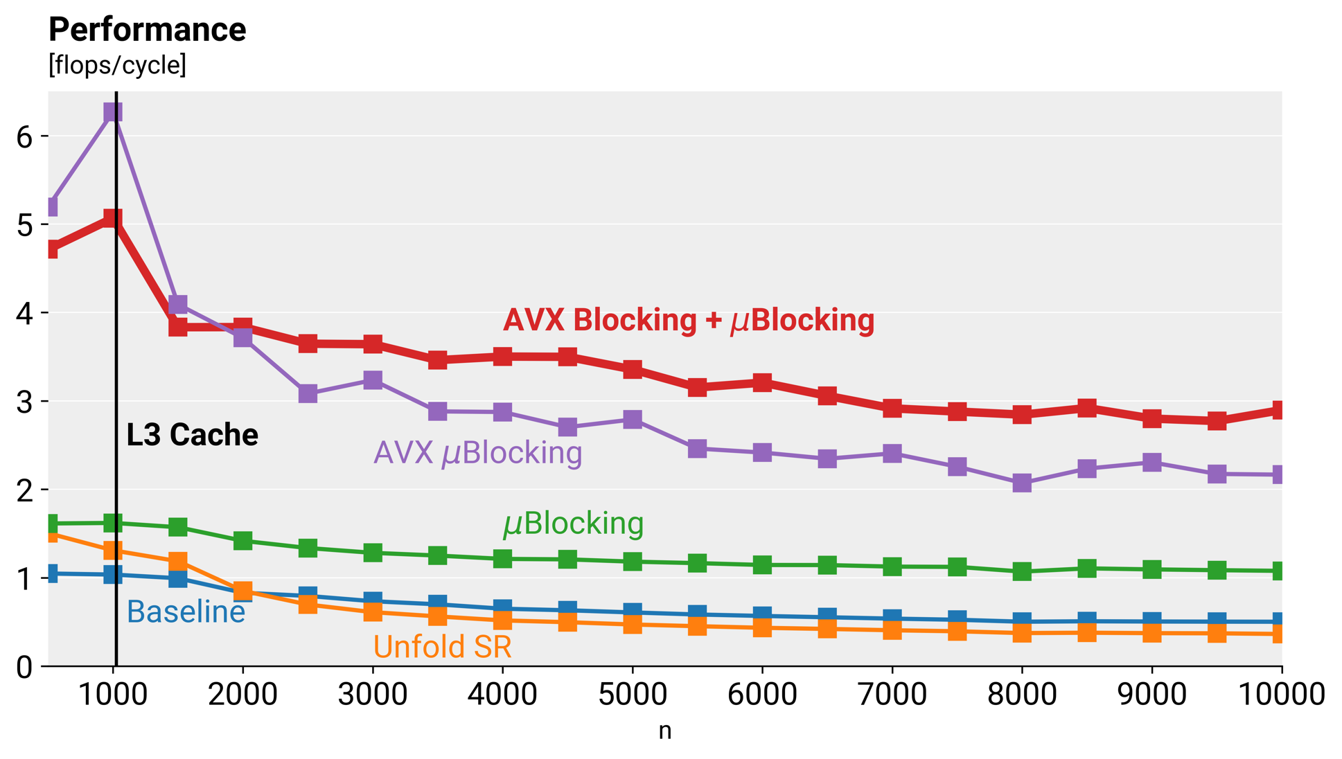
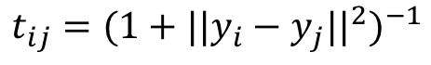
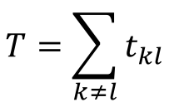
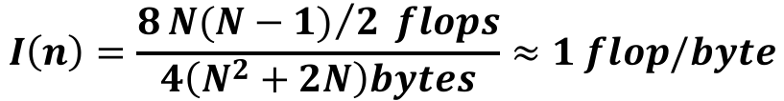
Part 3: Training Loop
Computation Low Dimensional Affinities
$$t_{ij}={(1+{||y_{i}−y_{j}||}^{2})}^{−1}$$
$$T=\sum_{k≠l}{t_{kl}}$$
$$I\left(n\right)=\frac{8{N(N−1)}/2 flops}{4\left(N^{2}+2N\right)bytes}≈1 flop/byte$$
Notes:
3rd part: Most important part. Executed ~1000 loop iterations. 1.) compute affinities 2.) compute gradients & update
Most expensive part of the algorithm (call the most).
The first step on the training loop consist on computing the low dimensional affinities on the embedded space which is 2 dimensional.
To compute it, it has been use the same approach previously used to compute the pairwise Euclidean distances for high dimensional vector but in this case, as the data has only 2 dimensions, the operational intensity is 1 and the performance memory bound.
The first approach to optimize the baseline code was to unfold the inner loops and use scalar replacement, but perform well for low input sizes but for larger ones perform worst than the baseline.
The a microblocking completely unfolding an 8x8 pairwise points distance computation which let to better results.
Vectorising this code improves even more the performance but the best performance of all is using a two level block (first 32x32 and inside this block compute by microblocks of 8x8).

Slide 12
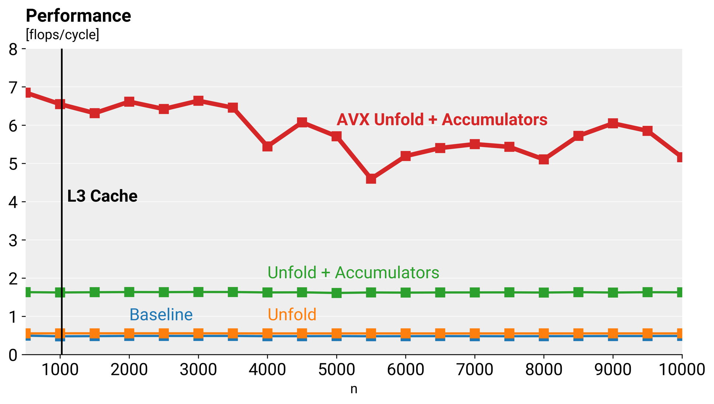
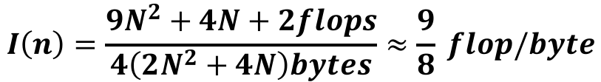

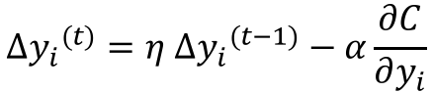
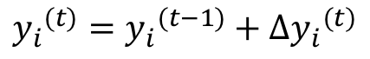
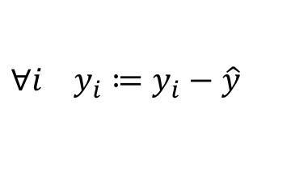
Part 3: Training Loop
$$\frac{∂C}{∂y_{i}}=\sum_{j}{\left(p_{ij}−\frac{t_{ij}}{T}\right)\left(y_{i}−y_{j}\right)t_{ij}}$$
Gradient Computation, Update and Normalize
$$Δ{y_{i}}^{(t)}=η Δ{y_{i}}^{(t−1)}−α\frac{∂C}{∂y_{i}}$$
$$I\left(n\right)=\frac{9N^{2}+4N+2flops}{4\left(2N^{2}+4N\right)bytes}≈\frac{9}{8} flop/byte$$
$${y_{i}}^{(t)}={y_{i}}^{(t−1)}+Δ{y_{i}}^{(t)}$$
$$∀i y_{i}≔y_{i}−\hat{y}$$
Notes:
The second part of the training loop, is given the pairwise affinities of the original space and the affinities of the embedding space previously computed, it computes a gradient for each point and update each point taking into account a momentum. Finally at the end of each training loop the embedding space has its mean subtracted.
The first approach to improve the baseline has been to unfold the inner loops which improvement is insignificantly. The next approach has been to keep accumulators for the gradient computation and mean computation and the last one which gave the best results was using AVX registers to store the accumulators.

Slide 13
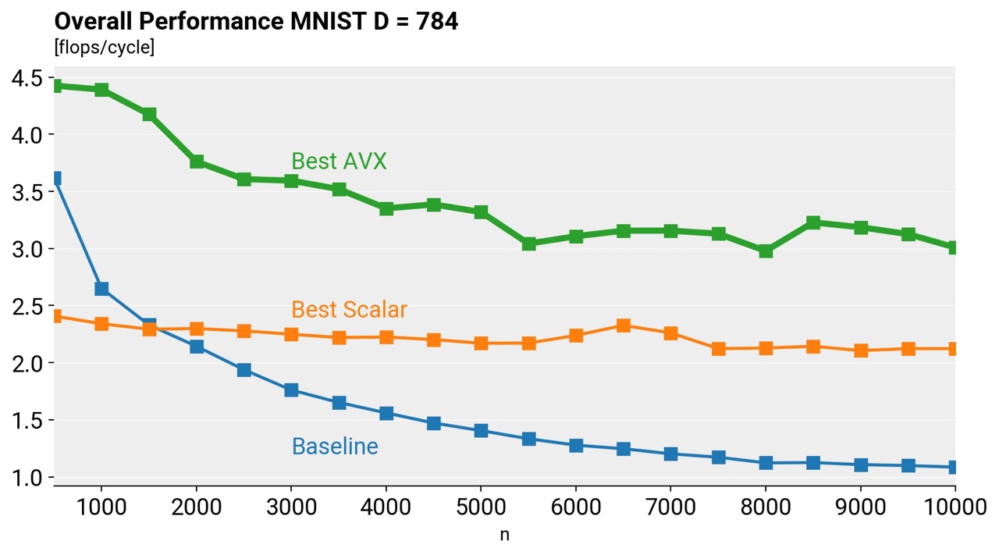
Overall
Notes:
We don’t know why this is so bad.
3-4 x speedup, which is also reflected by the fact that the low dimensional affinities (the most expensive part) had a speedup of 4-5x.

Slide 14
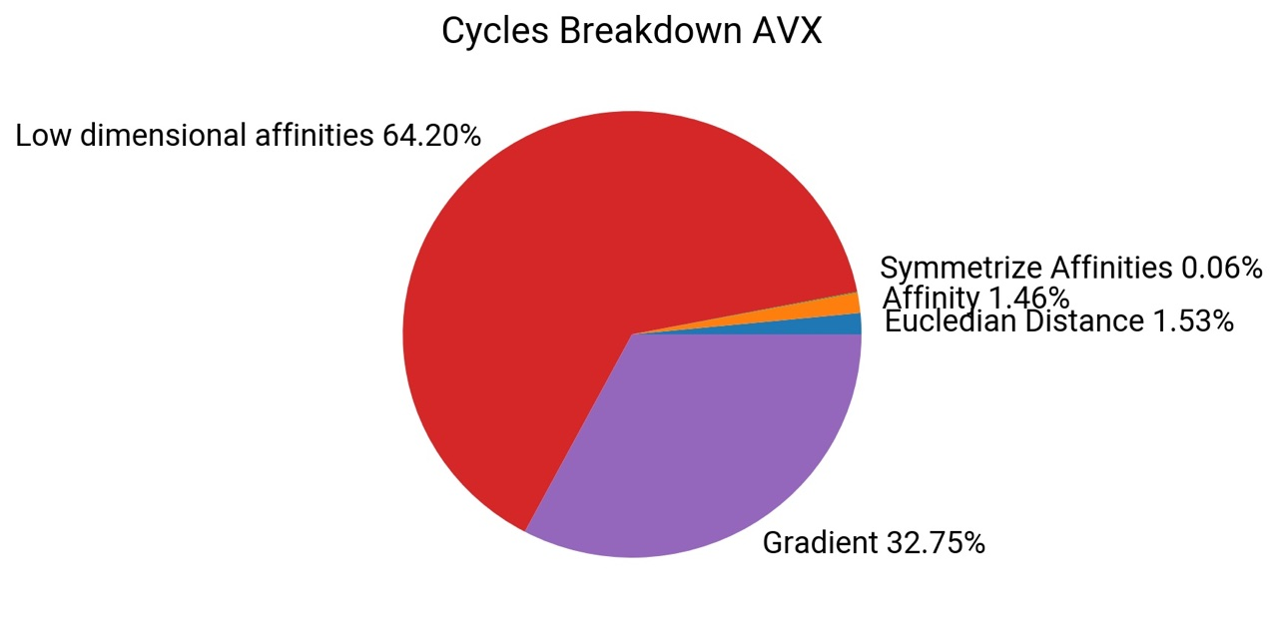
Notes:
Part 1 and 2 are now similarly expensive (before Part 1 was 5x Part 2)
Part 3 is still the bottleneck, but significantly reduced.
Why we can’t do better? Part 3 is bottleneck and Part 3 is memory bound.

